Slide 1
CODING WITH LIBRARIES → imaging (10 Feb)
Leandri Kleyn
Niel de Waal

Slide 2
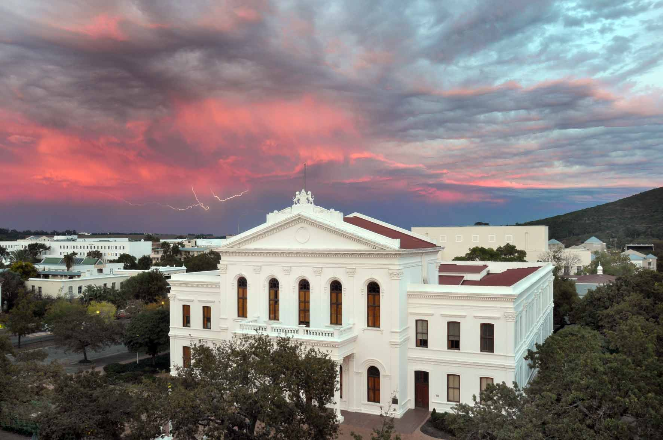
Starting with Imaging
import Image
im = Image.open('weerlig.jpg')
im.show()

Slide 3
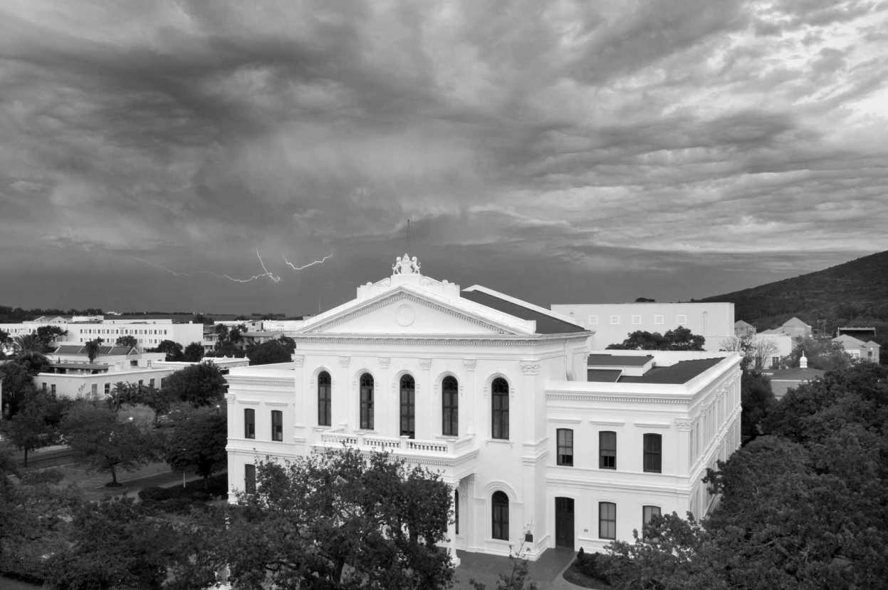
Black and White
im = Image.open('weerlig.jpg').convert(“L”)
To convert to color use “RGB” instead of “L”

Slide 4
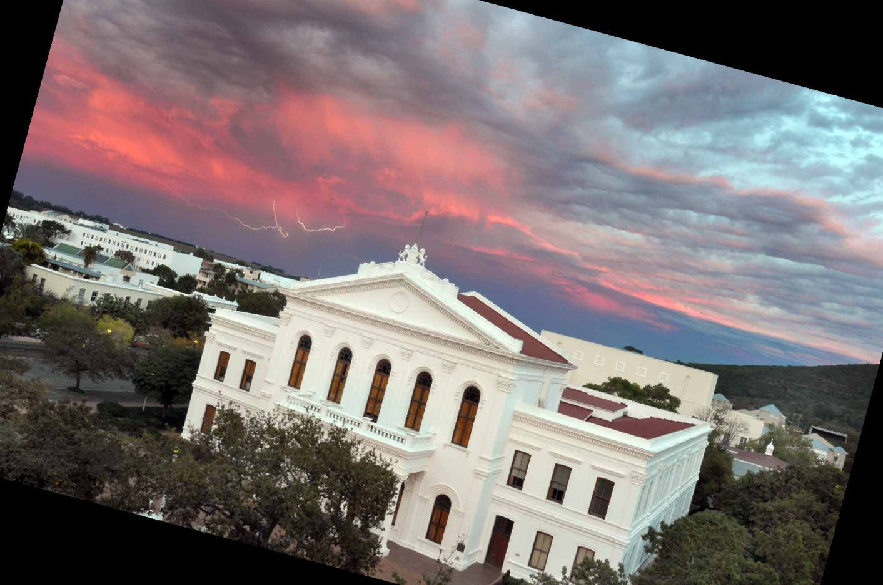
Rotation
im = im.rotate(-15)

Slide 5
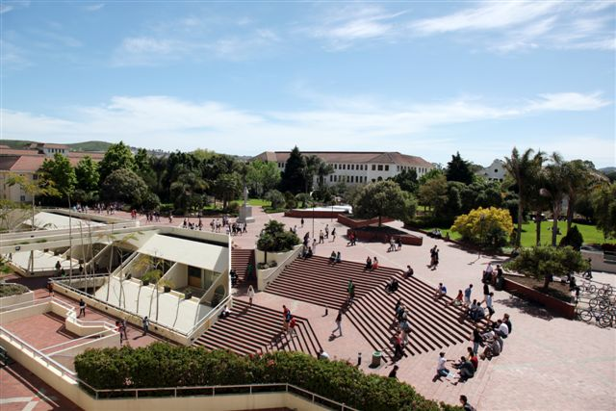
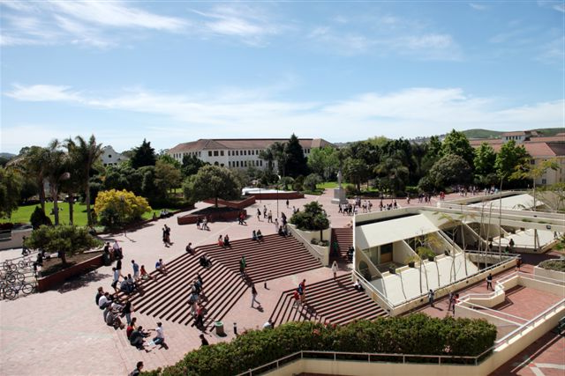
Transpose
flip = im.transpose(Image.FLIP_LEFT_RIGHT)

Slide 6
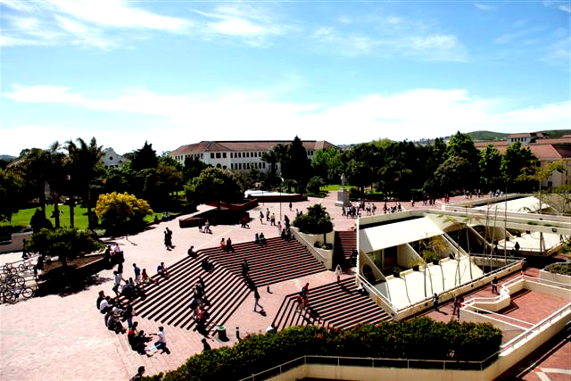
Enhancing/Contrast
enhancing = ImageEnhance.Contrast(flip)
enhancing.enhance(1.5).show()

